Slide 1



ROTARY DISTRICT 5340 MEMBERSHIP

Slide 2
MEMBERSHIP TIPS FOR ROTARY CLUBS!
Useful information about membership
you can put to use today.

Slide 3
WHO BROUGHT YOU IN ?
Friend
Boss / Co-Worker
Neighbor
Stranger
Or did you seek Rotary out?

Slide 4
WHat BROUGHT YOU IN ?
?

Slide 5
WHat BROUGHT YOU IN ?
?
Community Service
Networking
Leadership Skills
International Service
Friendship
Family Friendly
Opportunities for young people

Slide 6
WHY BRING IN A NEW MEMBER?
?

Slide 7
WITHOUT MEMBERSHIP GROWTH…
We do not enough hands to serve!
Less fresh ideas
No new energy
Nobody new for fellowship
There is NO Rotary for tomorrow!

Slide 8
WHAT a new MEMBER should be
Do we want just anyone?

Slide 9
WHAT a new MEMBER should be
What qualities do you look for a quality member to have?
?

Slide 10
WHAT a new MEMBER should be
So…..Is your club attractive to this ideal member?

Slide 11
WHAT a new MEMBER should be
Does your club provide a good value for their time and $$$ ?
What is your average billing rate?
Multiply by # of members
Multiply by 1.5 hours each week

Slide 12
WHAT a new MEMBER WANTS
What attracts new members and what keeps them in Rotary?

Slide 13
WHAT a MEMBER WANTS
Get involved in our communities
Connect with other professionals
Share time and experience with young people
Support global causes, such as eradicating polio
Use their skills to help others

Slide 14
WHAT a MEMBER WANTS
Attractive, interesting clubs that provide value, and give individuals a feeling of accomplishment?
Review your club’s attitude, environment, posture and direction.

Slide 15
Rotary clubs are like businesses
They must have clear direction
They must be consistent
They must provide value
They must be informative
They must care about their members!

Slide 16
Innovative and Flexible Rotary clubs are:
Fun, dynamic, diverse, resilient, tolerant,
interested in trying new things, proactive, member driven, results oriented, resourceful, inspirational, and relationship rich.
They support and strengthen their membership, focus and increase their humanitarian service, and enhance their public image and awareness.
-RI Quote from “Innovative Clubs”

Slide 17
RECRUITING
Past RI President Bill Boyd:
If we can explain who we are and what we can do, then we're in a position to say,
"Come join us.”

Slide 18
WHAT A MEMBER IS
We Are All Ambassadors Of Rotary
  Positive attitude towards the growth and goals of your club.
  Through our interaction with the public we create an avenue for growth in membership.

Slide 19
RECRUIT
Do your members know how to answer the question:
What is Rotary?
Wear your Rotary pin = People will ask you!
When they do……Do you have a Rotary
elevator speech?

Slide 20
RECRUIT
  Q: How many members are on your membership committee?
  A: ALL OF THEM!

Slide 21
RECRUIT OUTSIDE MEETING
Educate club members regarding the procedures for extending an invitation to a prospective member.
Build supportive membership teams
Invite prospects to service projects and special events.
Recognize members who invite & propose members
Maintain statistics on membership efforts

Slide 22
Do YOU SELL YOUR CLUB AT YOUR BIG EVENTS?

Slide 23

MEMBERSHIP SUCCESS CYCLE……
Reinvigorate
Recruit
Retain

Slide 24
Reminder: August is membership month…
So is September – July!

Slide 25
DISTRICT MEMBERSHIP CHALLENGE
52 days February 9th through March 25th
What can you do now to make your club attractive?
Can you recruit new members in 52 days?

Slide 26
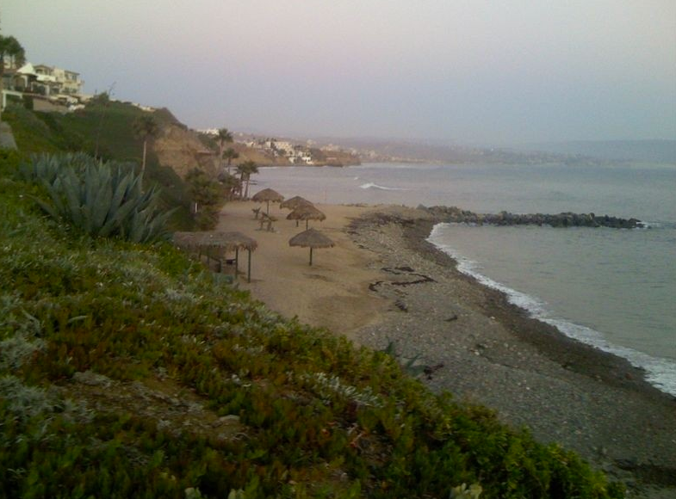
DISTRICT MEMBERSHIP CHALLENGE
Win for your club a two night stay at a beach house in Las Gaviotas, Rosarito Beach

Slide 27
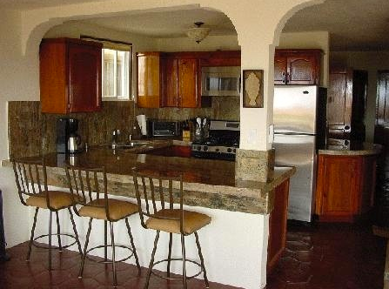
DISTRICT MEMBERSHIP CHALLENGE
Full House, 4 Bedrooms, 2 Baths (Sleeps 8)
Private Beach & Point Break!

Slide 28

DISTRICT MEMBERSHIP CHALLENGE
Full House, 4 Bedrooms, 2 Baths (Sleeps 8)
Private Beach & Point Break!

Slide 29
DISTRICT MEMBERSHIP CHALLENGE
Every new member will earn a bottle of fine wine
District will pay for the dinner at District Council 4/2 of all new members brought in during the contest.
Numbers based on Rotary.org data
The winning clubs must have a representative in attendance at District Council on Tue April 2nd for the wine and drawing.

Slide 30
MembersHip
“Every one of us in Rotary is here because we were invited, and because we made a choice to accept that invitation. Every day since then, we’ve been faced with another choice: whether to just be a member of a Rotary club, or to truly be a Rotarian”
– RIPE Ron Burton

Slide 31
Thanks for being a rotarian!
District Membership Chairperson 2011-13
San Diego Coastal Rotary Club
bobjamesjr@mac.com

