Slide 1

Grants Management Seminar – 16 March 2013
Mentor Training – 27 February 2010
Global
Grants
Management
Notes:
It is my pleasure to present an update on the Future Vision Plan of The Rotary Foundation. The Trustees have taken significant steps in reviewing the current programs and operations of our Foundation and envisioning its potential in our second century of service. We will be celebrating our 100th anniversary of the Foundation in the next decade, and we continually strive to improve our Foundation—making it stronger, more prominent, and more accessible.
The new grant structure of the new Future Vision Plan attempts to optimize contributions to our Foundation so that clubs and districts can maximize the use of funds for greater impact, greater flexibility, and greater sustainability in their work. The Foundation has listened to Rotarians’ concerns and formulated this strategy based on this feedback. The new grant structure attempts to optimize contributions to our Foundation so that clubs and districts can maximize the use of funds for greater impact, flexibility, and sustainability in their work.

Slide 2
What we will Cover
Overview of Changes
Club Qualification
Developing/Finding Projects
Applying for DDF Match
Applying for TRF World Fund Match
Project Implementation
Stewardship
Reporting

Slide 3
Overview of changes for 2013-14
The Future Vision Pilot is complete. We can do projects with any qualified Rotary Club.
Applying for DDF and the TRF match are completely separate.
The TRF process is now a one-step operation.
Increased emphasis on Sustainability
Increased emphasis on Stewardship
Outside funds are matched by TRF (but not by the District).

Slide 4

Mentor Training, February 27, 2010
Grants Management Seminar – 16 March 2013
Club
Qualification
Notes:
It is my pleasure to present an update on the Future Vision Plan of The Rotary Foundation. The Trustees have taken significant steps in reviewing the current programs and operations of our Foundation and envisioning its potential in our second century of service. We will be celebrating our 100th anniversary of the Foundation in the next decade, and we continually strive to improve our Foundation—making it stronger, more prominent, and more accessible.
The new grant structure of the new Future Vision Plan attempts to optimize contributions to our Foundation so that clubs and districts can maximize the use of funds for greater impact, greater flexibility, and greater sustainability in their work. The Foundation has listened to Rotarians’ concerns and formulated this strategy based on this feedback. The new grant structure attempts to optimize contributions to our Foundation so that clubs and districts can maximize the use of funds for greater impact, flexibility, and sustainability in their work.

Slide 5
Why have Qualification?
Provides Clubs with information on
Rotary grant procedures
Good project management practices
Financial stewardship requirements
Makes sure Club is current.

Slide 6
Club Qualification Requirements
Attendance by at least two Club members at the District’s Grant Management Seminar.
Club Memorandum of Understanding read, understood, and signed by
  Club President (2013-2014)
  President-elect (2014-2015 President)
Club must be current on all grant reporting.
Club must be current on District dues.
Club must be current on RI dues.

Slide 7
Memorandum of Understanding
Two pages, covering:
Terms of Qualification
Club Leadership Responsibilities for Qualification
Financial Management
Document Retention
Report on Use of Grant Funds
Method for Reporting and Resolving Misuse of Grant Funds

Slide 8
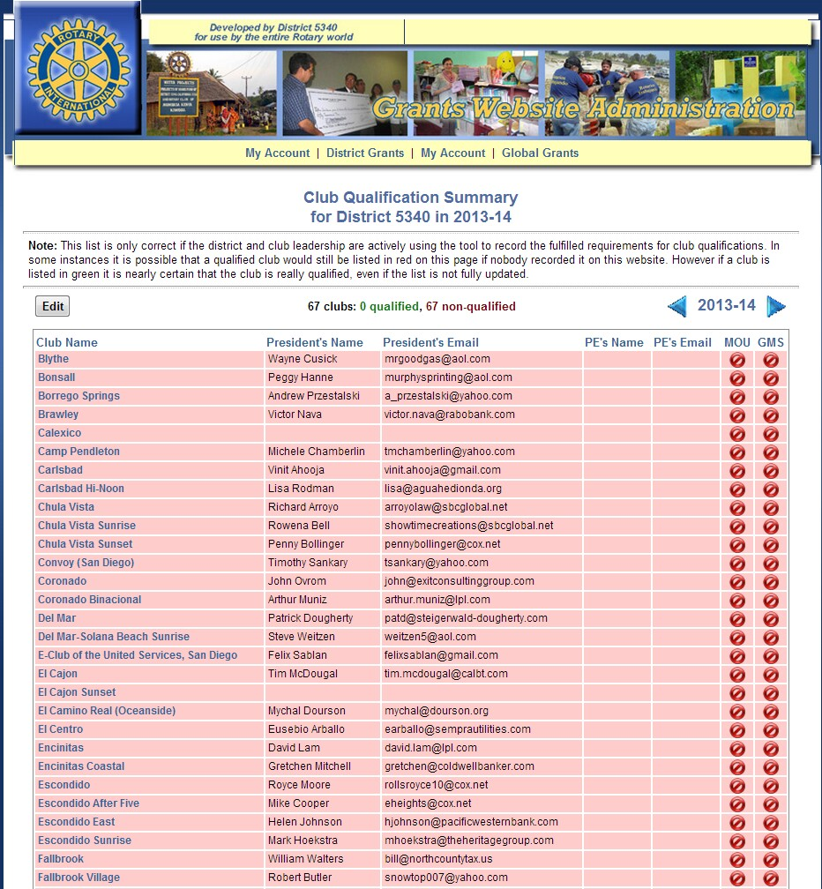
Online Qualification form

Slide 9
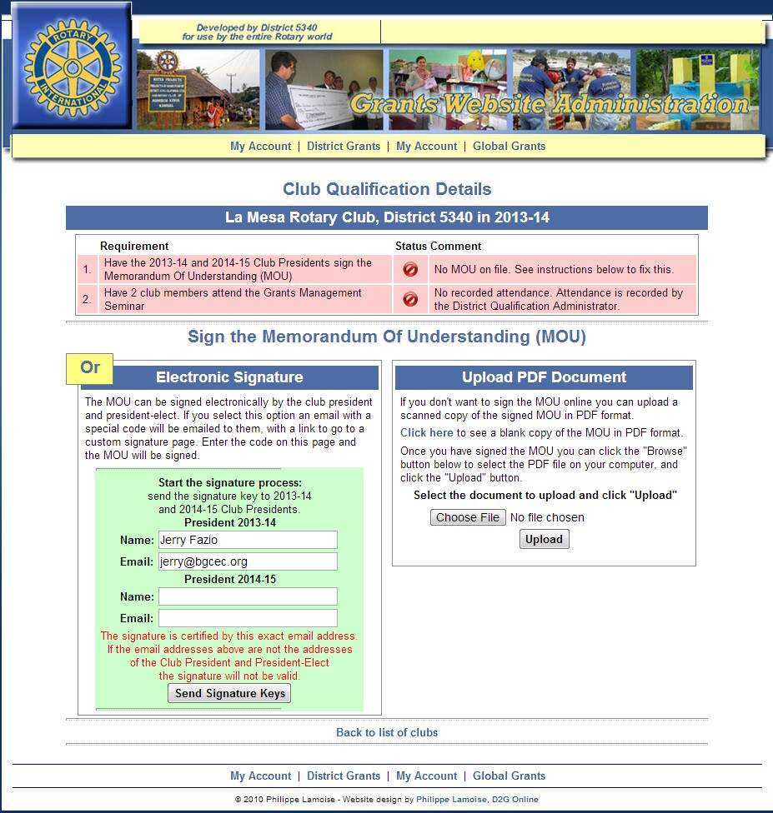

Slide 10
Grants Management Seminar – 16 March 2013
Mentor Training – 27 February 2010
Global
Grants
Notes:
It is my pleasure to present an update on the Future Vision Plan of The Rotary Foundation. The Trustees have taken significant steps in reviewing the current programs and operations of our Foundation and envisioning its potential in our second century of service. We will be celebrating our 100th anniversary of the Foundation in the next decade, and we continually strive to improve our Foundation—making it stronger, more prominent, and more accessible.
The new grant structure of the new Future Vision Plan attempts to optimize contributions to our Foundation so that clubs and districts can maximize the use of funds for greater impact, greater flexibility, and greater sustainability in their work. The Foundation has listened to Rotarians’ concerns and formulated this strategy based on this feedback. The new grant structure attempts to optimize contributions to our Foundation so that clubs and districts can maximize the use of funds for greater impact, flexibility, and sustainability in their work.

Slide 11
Global Grants - Outline
The Global Grant Overview
Finding/Developing a Project
Basic Funding Example
Applying for a DDF match
Applying for a TRF match
Project Management
Project Reporting
Timeline for 2013-2014 projects
Support, Resources and References
Questions

Slide 12
What is a Global Grant?
A project carried out by two Rotary clubs in different countries that meet The Rotary Foundation and District 5340 requirements.
Project funding comes from
  Clubs, organizations, and individuals
  Matched by District Designated Funds (DDF)
  Matched by The Rotary Foundation (TRF)

Slide 13
Types of Global Grants
Humanitarian
  May include microfinance
Vocational Training Teams
  Single specialty
  Adopt-A-Village, multi-specialty, by need
Global Scholar

Slide 14
TRF Global Grant Requirements
Requires two Qualified Sponsor Clubs in two Qualified Districts in different countries.
Must support Rotary’s Mission Statement

Slide 15
The Rotary Foundation Mission Statement
The mission of The Rotary Foundation is to enable Rotarians to advance world understanding, goodwill, and peace through the improvement of health, the support of education, and the alleviation of poverty.

Slide 16
TRF Global Grant Requirements
Requires two Qualified Sponsor Clubs in two Qualified Districts in different countries.
Must support Rotary’s Mission Statement
Must deal with at least one of the Foundation’s six Areas of Focus.

Slide 17
Rotary Foundation Areas of Focus
Peace and Conflict Prevention/Resolution
Disease Prevention and Treatment
Water and Sanitation
Maternal and Child Health
Basic Education and Literacy
Economic and Community Development

Slide 18
TRF Global Grant Requirements
Requires two Qualified Sponsor Clubs in two Qualified Districts in different countries.
Must support Rotary’s Mission Statement
Must deal with at least one of the Foundation’s six Areas of Focus.
The Rotary Foundation match must be at least $15,000 and not more than $200,000.
At least 30% of project funding must come from outside the Host country.

Slide 19
District 5340 requirements for 2013-14
The project must be fully pledged to be considered for DDF.
Clubs may Sponsor more than one Global Grant.
Club cash will be matched by DDF on a 1:1 basis up to $10,000 per Club for approved projects.
Clubs can partner to create larger projects.
Projects will be evaluated quarterly, starting July, 2013, continuing as long as there is DDF available, based on information posted www.matchinggrants.org/global on the first of the month.

Slide 20
Finding a Project
The best projects build on existing relationships and past successful projects.
Consult with a “Friends of District ______” contact.
Find new partners and projects on www.matchinggrants.org/global.
Go to a Global Grant Fair
Visit exhibitors at the RI Convention
Before committing to a new partnership, correspond with the Host Club and determine the timeliness and quality of their responses.

Slide 21
“Friends of District . . .”
District | Coordinator
3000, India (Tamil Nadu) | Dee Doe Dee@kingsroadinc.com
4100, Mexico | Bill Sparks bsleucadia@hotmail.com
4400, Ecuador | David Ballesteros david.ballesteros@sdsu.edu
9211 & 9212, East Africa | Philippe Lamoise philippe@lamoise.net
9370, South Africa | Marty Rosenstein shamartr@hotmail.com
3400 (3420), Indonesia | Kathleen Roche-Tansey roche-tansey@roadrunner.com

Slide 22
Creating a Project
Understand the needs of the community.
Make sure the community is involved in planning and execution.
Make sure there is a way to achieve Sustainability.
Make sure that everyone understands the Stewardship requirements, particularly how the money is handled, and records are kept.

Slide 23
Global Grant Funding
Cash provided by Clubs, Members, and other sources.
District Designated Funds (DDF) Match
  Matches Club cash up to $10,000 per club, if allocated by the DRFC.
  Clubs can cooperate to handle larger projects.
RI Match
  Cash is matched at 50%
  DDF is matched at 100%
  RI match must be at least $15,000 (and not more than $200,000)
  Cash from non-Rotary sources can be used, and is now matched by TRF.

Slide 24
Project Funding: A Basic Grant
Club Name (or District) |  | District | Cash | DDF | Total
Host Sponsor Club |  | 4400
International Sponsor Club |  | 5340 | $10,000 | $10,000 | $20,000
Club Cash and Total DDF : |  |  | $10,000 | $10,000 | $20,000
 | TRF match % |  | 50% | 100%
 | TRF match : |  | $5,000 | $10,000 | $15,000
 | District 5340 DDF: |  |  | $10,000
 |  |  | Total Project Funding: |  | $35,000

Slide 25
Global Grants – The Process in a Nutshell
Identify and plan the project.
On the District 5340 Global Grants Website,apply for DDF match:
  Submit a New Project.
  Complete Description/Proposal. When DDF is approved by the District 5340 Rotary Foundation Committee, continue.
On the RI website via Member Access, apply for TRF match:
  Submit an Application to TRF. When approved,
Submit Project Bank Account Information.
Collect the pledged money, send it to TRF.
TRF transfers the funds to the Project Bank Account
The Clubs implement the Project.
Submit timely Progress and Final Reports

Slide 26
Grants Management Seminar – 16 March 2013
Mentor Training – 27 February 2010
Applying for
DDF Match
Notes:
It is my pleasure to present an update on the Future Vision Plan of The Rotary Foundation. The Trustees have taken significant steps in reviewing the current programs and operations of our Foundation and envisioning its potential in our second century of service. We will be celebrating our 100th anniversary of the Foundation in the next decade, and we continually strive to improve our Foundation—making it stronger, more prominent, and more accessible.
The new grant structure of the new Future Vision Plan attempts to optimize contributions to our Foundation so that clubs and districts can maximize the use of funds for greater impact, greater flexibility, and greater sustainability in their work. The Foundation has listened to Rotarians’ concerns and formulated this strategy based on this feedback. The new grant structure attempts to optimize contributions to our Foundation so that clubs and districts can maximize the use of funds for greater impact, flexibility, and sustainability in their work.

Slide 27
Grants Management Seminar – 16 March 2013
Mentor Training – 27 February 2010
Competing for
DDF Match
Notes:
It is my pleasure to present an update on the Future Vision Plan of The Rotary Foundation. The Trustees have taken significant steps in reviewing the current programs and operations of our Foundation and envisioning its potential in our second century of service. We will be celebrating our 100th anniversary of the Foundation in the next decade, and we continually strive to improve our Foundation—making it stronger, more prominent, and more accessible.
The new grant structure of the new Future Vision Plan attempts to optimize contributions to our Foundation so that clubs and districts can maximize the use of funds for greater impact, greater flexibility, and greater sustainability in their work. The Foundation has listened to Rotarians’ concerns and formulated this strategy based on this feedback. The new grant structure attempts to optimize contributions to our Foundation so that clubs and districts can maximize the use of funds for greater impact, flexibility, and sustainability in their work.

Slide 28
Applying for DDF
On the District’s Global Grants website:
  Submit the Project.
  Describe the project in some detail.
  Provide a preliminary budget.
  On the Financing page, enter known pledges.
  Work to get the project fully pledged.

Slide 29
Three ways to describe your project
Enter a complete description* in the Description space.
Answer the Proposal questions on the online Proposal Form.
Upload a complete description* as a PDF document.
    *Consult the Grant Management Manual for content guidelines.

Slide 30
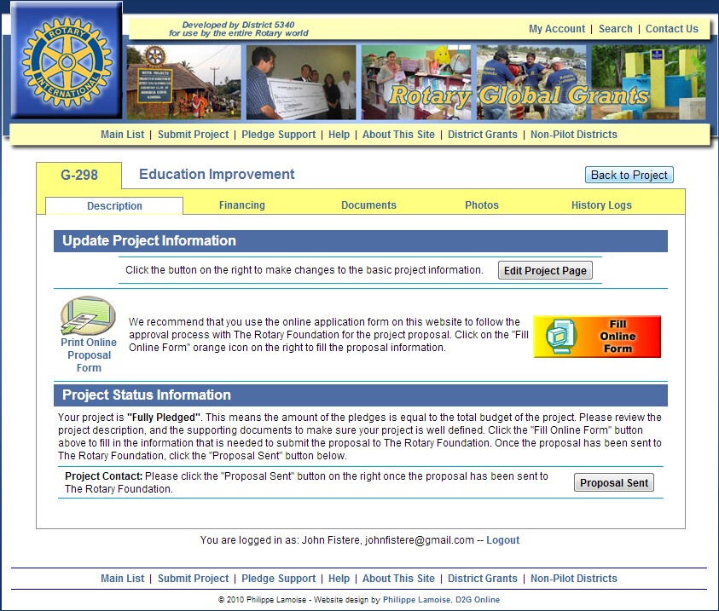
Entering the DDF request

Slide 31
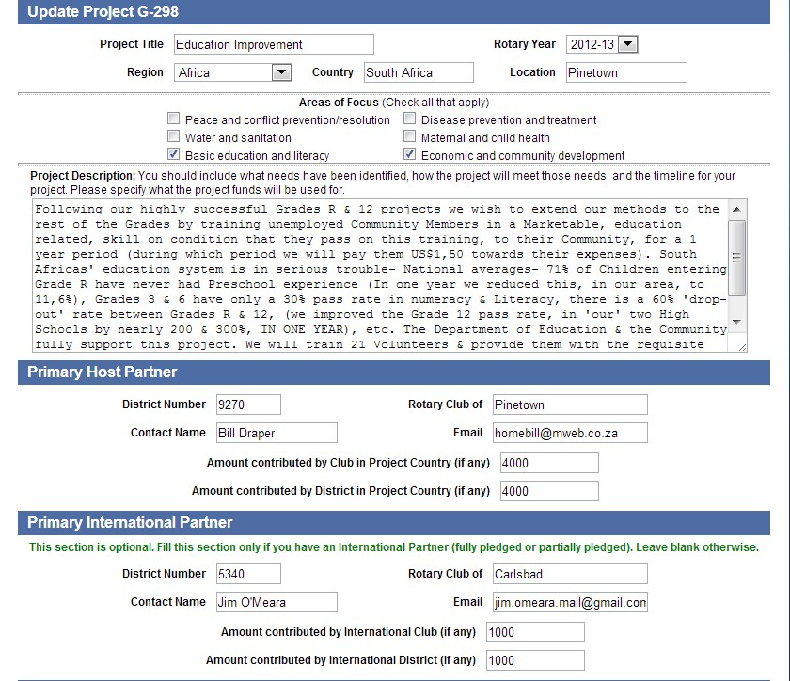
Modifying the Description, etc

Slide 32
Evaluation Criteria for DDF
Meets a well-defined significant need.
Deals with a Rotary “Area of Focus”
Efficiency (people served/$ DDF)
Community involvement
Rotarian involvement
Sustainability
Overall quality of proposal/planning
Annual Fund giving

Slide 33
DDF Allocations
About $60,000 will be available for Global Grants this year.
Allocations will be made quarterly, starting in July.
If we have more DDF requests than we have DDF available, allocations will be made on a competitive basis.

Slide 34
Grants Management Seminar – 16 March 2013
Mentor Training – 27 February 2010
Applying for
TRF Match
Notes:
It is my pleasure to present an update on the Future Vision Plan of The Rotary Foundation. The Trustees have taken significant steps in reviewing the current programs and operations of our Foundation and envisioning its potential in our second century of service. We will be celebrating our 100th anniversary of the Foundation in the next decade, and we continually strive to improve our Foundation—making it stronger, more prominent, and more accessible.
The new grant structure of the new Future Vision Plan attempts to optimize contributions to our Foundation so that clubs and districts can maximize the use of funds for greater impact, greater flexibility, and greater sustainability in their work. The Foundation has listened to Rotarians’ concerns and formulated this strategy based on this feedback. The new grant structure attempts to optimize contributions to our Foundation so that clubs and districts can maximize the use of funds for greater impact, flexibility, and sustainability in their work.

Slide 35
Applying for TRF World Fund Match
On the RI website, go to Member Access and log in or register.
Click on “Rotary Foundation Grants (2013-14)”
Explore the website.
Click on “Go to the app”
Click on “Global Grants”
Click on First Steps/”Start”
Identify the International and Host Primary Contacts.

Slide 36
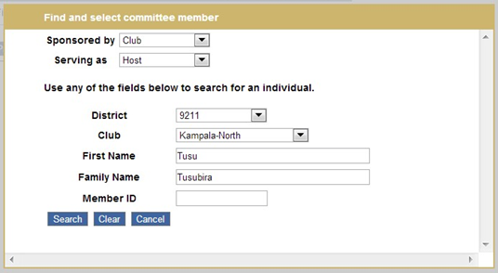
Identifying Primary Contacts

Slide 37
Applying for TRF World Fund Match
Then…
Answer the questions.
Be sure to include a budget.
Identify two more club members to form your Project Committee

Slide 38
Advice
Make sure:
  No “assessment” activity is included.
  You have identified actual needs, and a plan to meet those needs.
  The project deals with at least one of Rotary’s “Areas of Focus”
  You have established quantifiable goals and the means to measure the results.
  The project is “Sustainable”.

Slide 39
Grants Management Seminar – 16 March 2013
Mentor Training – 27 February 2010
Measurable Goals
and
Sustainability
Notes:
It is my pleasure to present an update on the Future Vision Plan of The Rotary Foundation. The Trustees have taken significant steps in reviewing the current programs and operations of our Foundation and envisioning its potential in our second century of service. We will be celebrating our 100th anniversary of the Foundation in the next decade, and we continually strive to improve our Foundation—making it stronger, more prominent, and more accessible.
The new grant structure of the new Future Vision Plan attempts to optimize contributions to our Foundation so that clubs and districts can maximize the use of funds for greater impact, greater flexibility, and greater sustainability in their work. The Foundation has listened to Rotarians’ concerns and formulated this strategy based on this feedback. The new grant structure attempts to optimize contributions to our Foundation so that clubs and districts can maximize the use of funds for greater impact, flexibility, and sustainability in their work.

Slide 40
Measurable Goals
Measured numerically
Be sure to establish a baseline.

Slide 41
Sustainability
Sustainability means providing long-term solutions to community needs that the benefiting community can maintain after the grant funding ends.

Slide 42
Sustainability
Community: Needs and Strengths
Materials & Technology: Local if possible
Funding: Long term
Knowledge: Training & Outreach
Motivation: Incentives & Ownership
Monitoring: For at least three years

Slide 43
Grants Management Seminar – 16 March 2013
Mentor Training – 27 February 2010
Implementing
the
Project
Notes:
It is my pleasure to present an update on the Future Vision Plan of The Rotary Foundation. The Trustees have taken significant steps in reviewing the current programs and operations of our Foundation and envisioning its potential in our second century of service. We will be celebrating our 100th anniversary of the Foundation in the next decade, and we continually strive to improve our Foundation—making it stronger, more prominent, and more accessible.
The new grant structure of the new Future Vision Plan attempts to optimize contributions to our Foundation so that clubs and districts can maximize the use of funds for greater impact, greater flexibility, and greater sustainability in their work. The Foundation has listened to Rotarians’ concerns and formulated this strategy based on this feedback. The new grant structure attempts to optimize contributions to our Foundation so that clubs and districts can maximize the use of funds for greater impact, flexibility, and sustainability in their work.

Slide 44
Project Management
Get a clear understanding and agreement in advance with the Host Club on their responsibilities.
Encourage the Host Club to use the document storage feature of matchinggrants.org/global and the mailing list feature for project communications.
Show that you are interested and need information back here frequently for informal reports. Keep in touch. Skype works.
A visit to the project site is a great way to keep in touch.
Follow up on due dates in advance.
Stay current on reporting.

Slide 45
Project Bank Account
An account dedicated to the project must be set up.
  (An overseas USD account requires the bank to name a US “correspondent bank”).
Account may be set up and managed by either the Host Club or the International Club.
Two signatories are required. They must go the project via RI Member Access and confirm their assignment.

Slide 46
Collecting Pledged Money
Collect all pledges with checks made out to TRF.
When all have been received, send them to TRF with a Multiple Donor Form (123-EN).

Slide 47
TRF Funds the Project
The Rotary Foundation receives the pledged cash from the Host and International sources.
TRF wires the total of Cash, DDF, and RI Match to the Project Account.
The project is now “Paid”. The clock has started! A report is due in 12 months.
Get the report done early.

Slide 48
Using the District 5340 Global Grants Website
The District 5340 Global Grants website allows you to:
Find or Publicize a Project.
Request a District 5340 DDF allocation.
Request cash pledges and DDF support for the project.
Permanently store the application, project reports, significant emails, photos, invoices, receipts, bank statements & other relevant documents.
Report project status in the History Log
Designate who has access to your project.
Customize your project mailing list.
Send emails to everyone on your project mailing list.

Slide 49
Grants Management Seminar – 16 March 2013
Mentor Training – 27 February 2010
Stewardship
Notes:
It is my pleasure to present an update on the Future Vision Plan of The Rotary Foundation. The Trustees have taken significant steps in reviewing the current programs and operations of our Foundation and envisioning its potential in our second century of service. We will be celebrating our 100th anniversary of the Foundation in the next decade, and we continually strive to improve our Foundation—making it stronger, more prominent, and more accessible.
The new grant structure of the new Future Vision Plan attempts to optimize contributions to our Foundation so that clubs and districts can maximize the use of funds for greater impact, greater flexibility, and greater sustainability in their work. The Foundation has listened to Rotarians’ concerns and formulated this strategy based on this feedback. The new grant structure attempts to optimize contributions to our Foundation so that clubs and districts can maximize the use of funds for greater impact, flexibility, and sustainability in their work.

Slide 50
Financial Management
The Project Account must be maintained.
Money must be managed by a Rotarian.
Project invoices must be paid out of the Project Account.
A detailed ledger is required.
Invoices, receipts, ledger, and bank statements must be retained and be available for at least five years. (Use the Global Grants website.)

Slide 51
Memoranda of Understanding
There are several different MOUs required for different situations
  Sponsor Club Presidents must sign an MOU.
  Cooperating Organizations and the Sponsor Clubs must sign an MOU.
  Global Grant Scholars must sign an MOU.
  Microfinance Organizations must sign an MOU.

Slide 52
Grants Management Seminar – 16 March 2013
Mentor Training – 27 February 2010
Reporting
Notes:
It is my pleasure to present an update on the Future Vision Plan of The Rotary Foundation. The Trustees have taken significant steps in reviewing the current programs and operations of our Foundation and envisioning its potential in our second century of service. We will be celebrating our 100th anniversary of the Foundation in the next decade, and we continually strive to improve our Foundation—making it stronger, more prominent, and more accessible.
The new grant structure of the new Future Vision Plan attempts to optimize contributions to our Foundation so that clubs and districts can maximize the use of funds for greater impact, greater flexibility, and greater sustainability in their work. The Foundation has listened to Rotarians’ concerns and formulated this strategy based on this feedback. The new grant structure attempts to optimize contributions to our Foundation so that clubs and districts can maximize the use of funds for greater impact, flexibility, and sustainability in their work.

Slide 53
Global Grants Project Reporting
A Progress Report is due 12 months after TRF funds are disbursed, and every 12 months thereafter.
The Final Report is due two months after completion of project and includes an explanation of variances > 10%.
Bank statements for all expenses are required for both Progress and Final Reports.
Reports are submitted online through RI Member Access, completing the appropriate forms plus uploads.
  (Projects in India have special reporting requirements.)
  (There are special reports for VTTs, Global Scholars, and Microfinance projects.)

Slide 54
Report Content
How partners were involved
Type of activity
Evaluation of project goals
How “Area of Focus” goals were met
How funds were spent
Number of beneficiaries and how they benefited.

Slide 55
Pitfalls to Avoid
Sustainability plan not provided.
Financing shown is not based on actual pledges.
Not providing required MOUs.
Funds were transferred from Project Account to another organization.
Not getting signatures when needed.
Uploaded bank statements not legible, or cannot be matched to reported expenses.
Late reports. Most frequent problem. Affects other projects.

Slide 56
Congratulations!
You and your Host Club have completed your Global Grant Project.
Now tell the world about it.
  Upload pictures and stories.
  Write a press release.
  Offer to do Club presentations
  Write an article for the Rotarian.

Slide 57
Global Grants Timeline 2013-2014
DDF and RI match requests can be entered into each system now.
Evaluation for DDF will occur quarterly starting in July. as long as there is DDF available.
From DDF approval to RI Application approval: six months.
From RI approval to completion of fundraising: six months.
An overdue project may lose its DDF allocation.
Progress Report due every 12 months.
Final Report due two months after project completion.

Slide 58
Grants Management Seminar – 16 March 2013
Mentor Training – 27 February 2010
Resources
Notes:
It is my pleasure to present an update on the Future Vision Plan of The Rotary Foundation. The Trustees have taken significant steps in reviewing the current programs and operations of our Foundation and envisioning its potential in our second century of service. We will be celebrating our 100th anniversary of the Foundation in the next decade, and we continually strive to improve our Foundation—making it stronger, more prominent, and more accessible.
The new grant structure of the new Future Vision Plan attempts to optimize contributions to our Foundation so that clubs and districts can maximize the use of funds for greater impact, greater flexibility, and greater sustainability in their work. The Foundation has listened to Rotarians’ concerns and formulated this strategy based on this feedback. The new grant structure attempts to optimize contributions to our Foundation so that clubs and districts can maximize the use of funds for greater impact, flexibility, and sustainability in their work.

Slide 59
Resources www.rotary5340.org
Go to the District 5340 website
Click on Rotary Foundation.
Check the Foundation News Center
Click on Humanitarian Programs
Check the Global Grants News Center

Slide 60
Resources www.rotary.org
Go to the RI website
Use the Search function

Slide 61
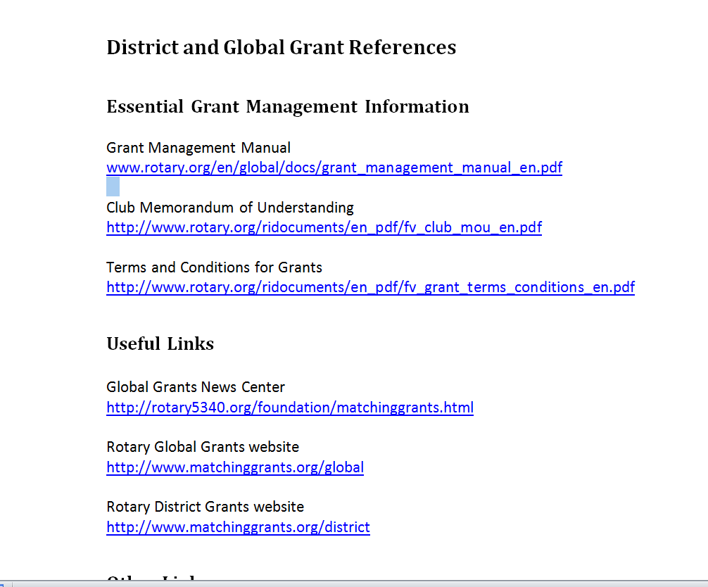
Links to Information (will be emailed)

Slide 62
Grants Management Seminar – 16 March 2013
Mentor Training – 27 February 2010
Global
Grants
Q&A
Notes:
It is my pleasure to present an update on the Future Vision Plan of The Rotary Foundation. The Trustees have taken significant steps in reviewing the current programs and operations of our Foundation and envisioning its potential in our second century of service. We will be celebrating our 100th anniversary of the Foundation in the next decade, and we continually strive to improve our Foundation—making it stronger, more prominent, and more accessible.
The new grant structure of the new Future Vision Plan attempts to optimize contributions to our Foundation so that clubs and districts can maximize the use of funds for greater impact, greater flexibility, and greater sustainability in their work. The Foundation has listened to Rotarians’ concerns and formulated this strategy based on this feedback. The new grant structure attempts to optimize contributions to our Foundation so that clubs and districts can maximize the use of funds for greater impact, flexibility, and sustainability in their work.

Slide 63


